Slide 1
Chapter 13 Recursion, Complexity, and Searching and Sorting
Fundamentals of Java: AP Computer Science Essentials, 4th Edition
Lambert / Osborne

Slide 2
Objectives
Design and implement a recursive method to solve a problem.
Understand the similarities and differences between recursive and iterative solutions of a problem.
Check and test a recursive method for correctness.
‹#›
‹#›

Slide 3
Objectives (continued)
Understand how a computer executes a recursive method.
Perform a simple complexity analysis of an algorithm using big-O notation.
Recognize some typical orders of complexity.
Understand the behavior of a complex sort algorithm such as the quicksort.
‹#›
‹#›

Slide 4
Vocabulary
activation record
big-O notation
binary search algorithm
call stack
complexity analysis
infinite recursion
iterative process
merge sort
quicksort
recursive method
recursive step
stack
stack overflow error
stopping state
tail-recursive
‹#›
‹#›

Slide 5
Introduction
Searching and sorting can involve recursion and complexity analysis.
Recursive algorithm: refers to itself by name in a manner that appears to be circular.
Common in computer science.
Complexity analysis: determines an algorithm’s efficiency.
Run-time, and memory usage v. data processed.
‹#›
‹#›

Slide 6

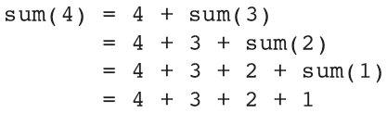
Recursion
Adding integers 1 to n iteratively:
Another way to look at the problem:
Seems to yield a circular definition, but it doesn’t.
Example: calculating sum(4):
‹#›
‹#›

Slide 7
Recursion (continued)
Recursive functions: the fact that sum(1) is defined to be 1 without making further invocations of sum saves the process from going on forever and the definition from being circular.
Iterative:
factorial(n) = 1*2*3* n, where n>=1
Recursive:
factorial(1)=1; factorial(n)=n*factorial(n-1) if n>1
‹#›
‹#›

Slide 8
Recursion (continued)
Recursion involves two factors:
Some function f(n) is expressed in terms of f(n-1) and perhaps f(n-2) and so on.
To prevent the definition from being circular, f(1) and perhaps f(2) and so on are defined explicitly.
Implementing Recursion:
Recursive method: one that calls itself.
‹#›
‹#›

Slide 9
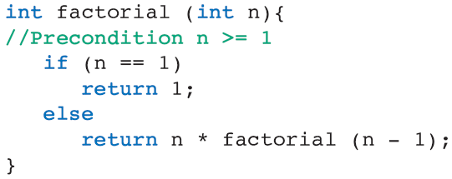
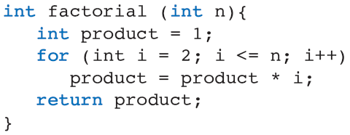
Recursion (continued)
Recursive:
Iterative:
‹#›
‹#›

Slide 10
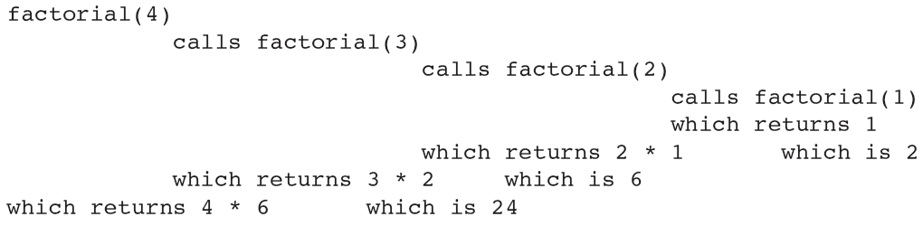
Recursion (continued)
Tracing Recursive Calls:
When the last invocation completes, it returns to its predecessor, etc. until the original invocation reactivates and finishes the job.
‹#›
‹#›

Slide 11
Recursion (continued)
Guidelines for Writing Recursive Methods:
Must have a well-defined stopping state.
Recursive step must lead to the stopping state.
If not, infinite recursion occurs.
Program runs until user terminates, or stack overflow error occurs when Java interpreter runs out of money.
‹#›
‹#›

Slide 12
Recursion (continued)
Run-Time Support for Recursive Methods:
Call stack: large storage area created at start-up.
Activation record: added to top of call stack when a method is called.
Space for parameters passed to the method, method’s local variables, and value returned by method.
When a method returns, its activation record is removed from the top of the stack.
‹#›
‹#›

Slide 13
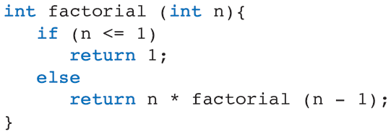
Recursion (continued)
Run-Time Support for Recursive Methods (cont):
Example: an activation record for this method includes:
Value of parameter n.
The return value of factorial.
‹#›
‹#›

Slide 14
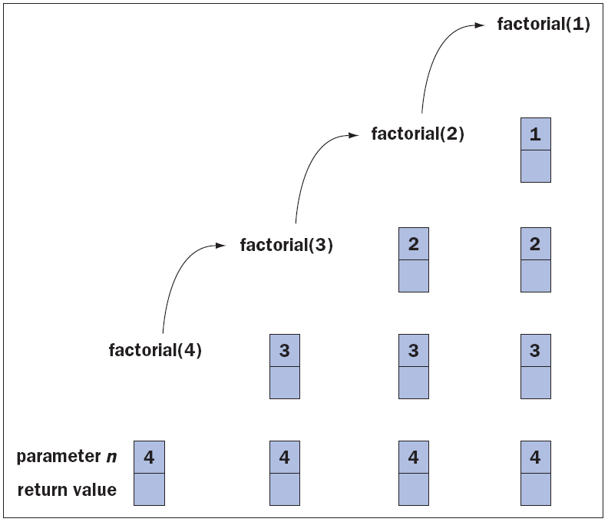
Recursion (continued)
Run-Time Support for Recursive Methods (cont):
Activation records on the call stack during recursive calls to factorial
‹#›
‹#›

Slide 15
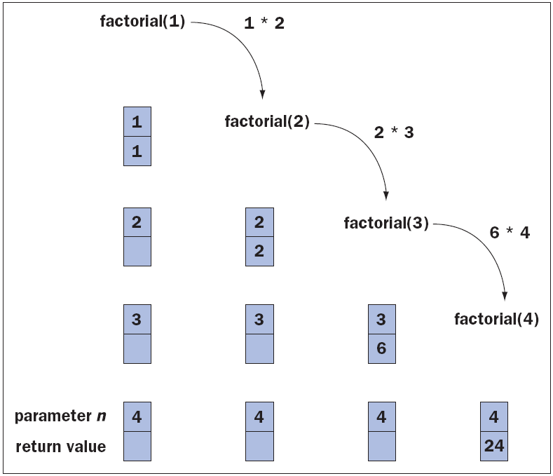
Recursion (continued)
Run-Time Support for Recursive Methods (cont):
Activation records on the call stack during returns from recursive calls to factorial
‹#›
‹#›

Slide 16
Recursion (continued)
When to Use Recursion:
Can be used in place of iteration and vice versa.
There are many situations in which recursion is the clearest, shortest solution.
Examples: Tower of Hanoi, Eight Queens problem.
Tail recursive: no work done until after a recursive call.
‹#›
‹#›

Slide 17
Complexity Analysis
Complexity analysis asks questions about the methods we write, such as:
What is the effect on the method of increasing the quantity of data processed?
How does doubling the amount of data affect the method’s execution time (double, triple, no effect?).
‹#›
‹#›

Slide 18
Complexity Analysis (continued)
Sum Methods:
Big-O notation: the linear relationship between an array’s length and execution time (order n).
The method goes around the loop n times, where n represents the array’s size.
From big-O perspective, no distinction is made between one whose execution time is 1000000 + 1000000 *n and n/ 1000000, although the practical difference is enormous.
‹#›
‹#›

Slide 19
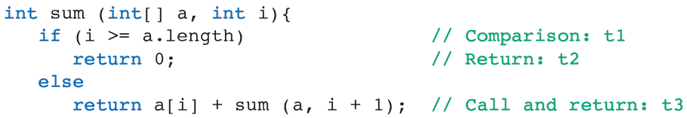
Complexity Analysis (continued)
Sum Methods (continued):
Complexity analysis can be applied to recursive methods.
A single activation of the method take time:
and
‹#›
‹#›

Slide 20
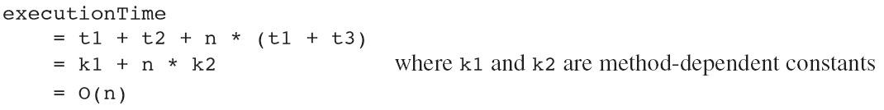
Complexity Analysis (continued)
Sum Methods (continued):
The first case occurs once and second case occurs the a.length times that the method calls itself recursively.
If n equals a.length, then:
‹#›
‹#›

Slide 21
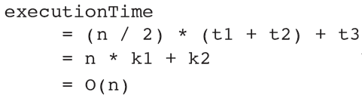
Complexity Analysis (continued)
Other O(n) Methods:
Example: each time through the loop, a comparison is made. If and when a match is found, the method returns from the loop with the search value’s index. If the search is made for values in the array, then half the elements would be examined before a match is found.
‹#›
‹#›

Slide 22
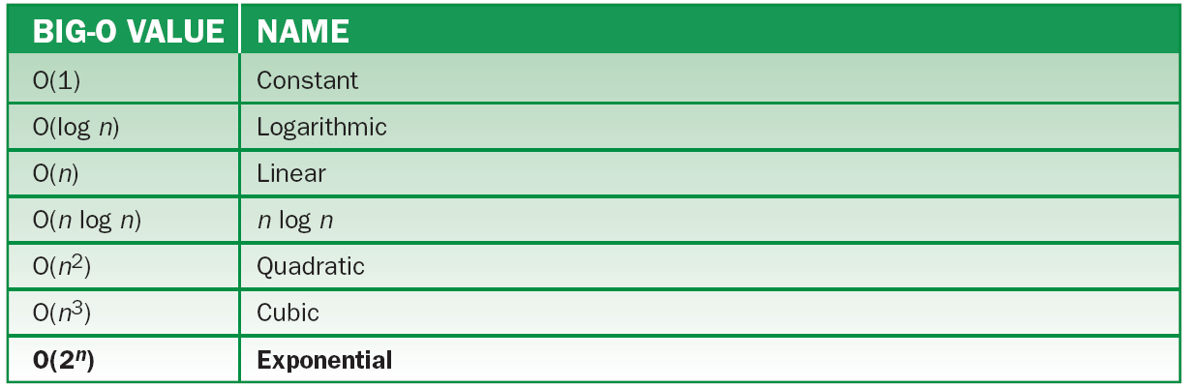
Complexity Analysis (continued)
Common Big-O Values:
Names of some common big-O values, listed from “best” to “worst”
‹#›
‹#›

Slide 23
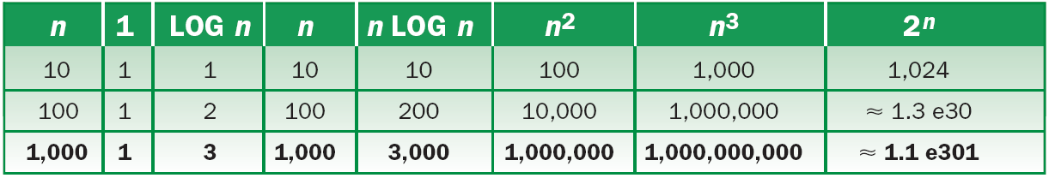
Complexity Analysis (continued)
Common Big-O Values (continued):
How big-O values vary depending on n
An O(r^{n}) Method:
Recursive method for computing Fibonacci numbers, where r ≈ 1.62.
‹#›
‹#›

Slide 24
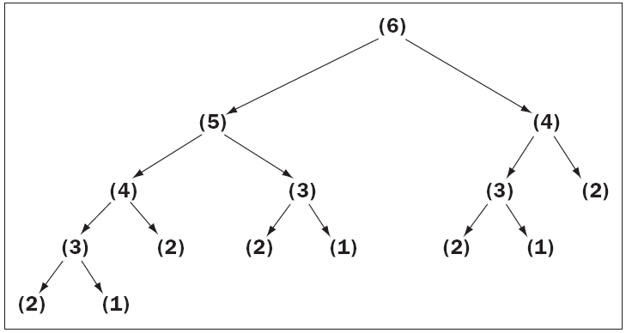
Complexity Analysis (continued)
Common Big-O Values (continued):
Calls needed to compute the sixth Fibonacci number recursively
‹#›
‹#›

Slide 25
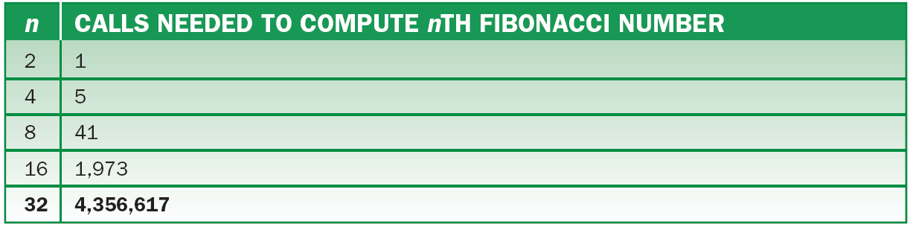
Complexity Analysis (continued)
Common Big-O Values (continued):
Calls needed to compute the nth Fibonacci number recursively
‹#›
‹#›

Slide 26
Complexity Analysis (continued)
Best-Case, Worst-Case, and Average-Case Behavior:
Best: Under what circumstances does an algorithm do the least amount of work? What is the algorithm’s complexity in this best case?
Worst: Under what circumstances does an algorithm do the most amount of work? What is the algorithm’s complexity in this worst case?
‹#›
‹#›

Slide 27
Complexity Analysis (continued)
Best-Case, Worst-Case, and Average-Case Behavior (continued):
Average: Under what circumstances does an algorithm do a typical amount of work? What is the algorithm’s complexity in this typical case?
There are algorithms whose best- and average-cases are similar, but whose behaviors degrade in the worst-case.
‹#›
‹#›

Slide 28
Binary Search
If a list is in ascending order, the search value can be found or its absence determined quickly using a binary search algorithm.
O(log n).
Start by looking in the middle of the list.
At each step, the search region is reduced by 2.
A list of 1 million entries involves at most 20 steps.
‹#›
‹#›

Slide 29
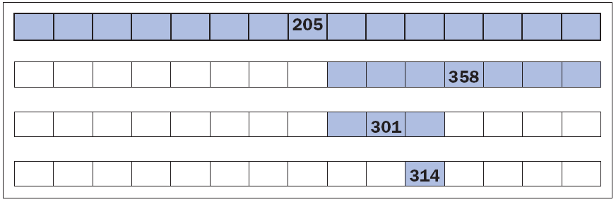
Binary Search (continued)
Binary search algorithm
The list for the binary search algorithm with all numbers visible
‹#›
‹#›

Slide 30
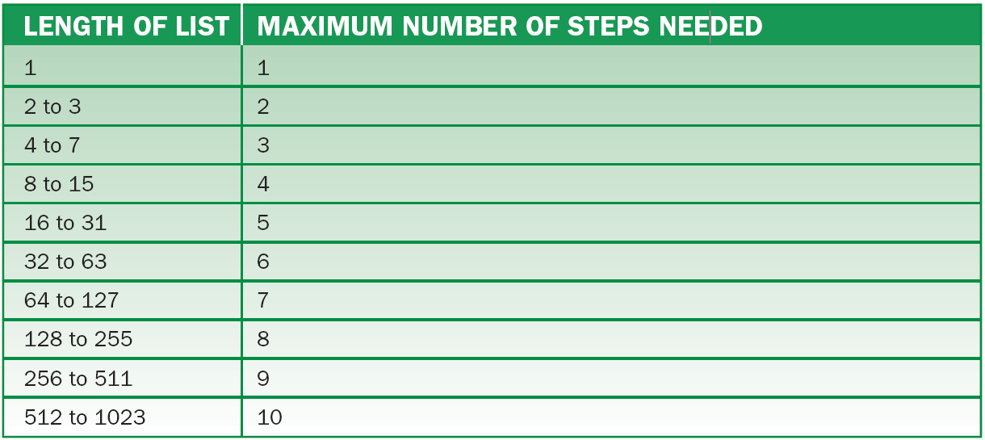
Binary Search (continued)
Maximum number of steps need to binary search lists of various sizes
‹#›
‹#›

Slide 31
Quicksort
Quicksort: An algorithm that is O(n log n).
Break an array into two parts, then move the elements so that the larger values are in one end and the smaller values are in the other.
Each part is subdivided in the same way, until the subparts contain only a single value.
Then the array is sorted.
‹#›
‹#›

Slide 32
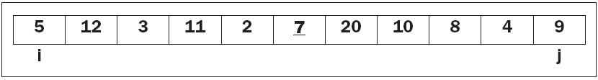
Quicksort (continued)
Phase 1:
Step 1: if the array length is less than 2, it is done.
Step 2: locates the pivot (middle value), 7.
Step 3: Tags elements at left and right ends as i and j.
‹#›
‹#›

Slide 33
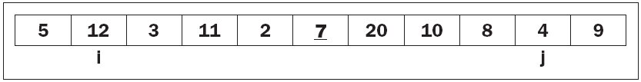
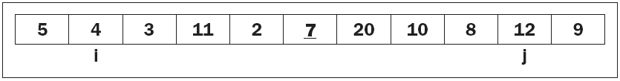
Quicksort (continued)
Step 4:
While a[i] < pivot value, increment i.
While a[j] > pivot value, decrement j.
Step 5: if i > j, then end the phase. Else, interchange a[i] and a[j]
‹#›
‹#›

Slide 34
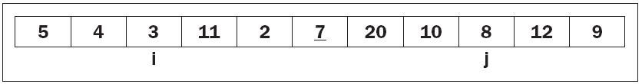
Quicksort (continued)
Step 6: increment i and decrement j.
Steps 7-9: repeat steps 4-6.
Step 10-11: repeat steps 4-5.
Step 12: the phase is ended. Split the array into two subarrays a[0…j] and a[i…10].
‹#›
‹#›

Slide 35
Quicksort (continued)
Phase 2 and Onward:
Repeat the process to the left and right subarrays until their lengths are 1.
Complexity Analysis:
At each move, either an array element is compared to the pivot or an interchange takes place. The process stops when I and j pass each other. Thus, the work is proportional to the array’s length (n).
‹#›
‹#›

Slide 36
Quicksort (continued)
Complexity Analysis (continued):
Phase 2, the work is proportional to the left plus right subarrays’ lengths, so it is proportional to n.
To complete the analysis, you need to know how many times the array are subdivided.
Best case: O(n log I)
Worst case: O(n²).
Implementation:
An iterative approach requires a data structure called a stack.
‹#›
‹#›

Slide 37
Merge Sort
Merge sort: a recursive, divide-and-conquer strategy to break the O(n²) barrier.
Compute the middle position of an array, and recursively sort its left and right subarrays.
Merge the subarrays back into a single sorted array.
Stop the process when the subarrays cannot be subdivided.
‹#›
‹#›

Slide 38
Merge Sort (continued)
This top-level design strategy can be implemented by three Java methods:
mergeSort: the public method called by clients.
mergeSortHelper: a private helper method that hides the extra parameter required by recursive calls.
merge: a private method that implements the merging process.
‹#›
‹#›

Slide 39
Merge Sort (continued)
copyBuffer: an extra array used in merging.
Allocated once in mergeSort, then passed to mergeSortHelper and merge.
When mergeSortHelper is called, it needs to know the low and high (parameters that bound the subarray).
After verifying that it has been passed a subarray of at least two items, mergeSortHelper computes the midpoint, sorts above and below, and calls merge to merge the results.
‹#›
‹#›

Slide 40
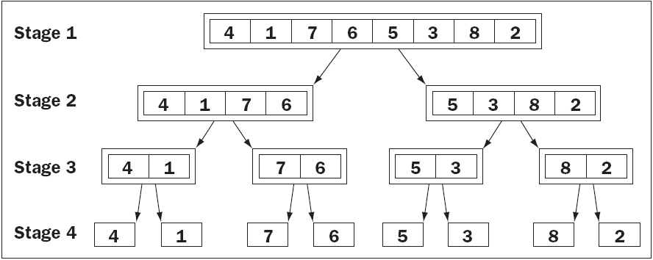
Merge Sort (continued)
Subarrays generated during calls of mergeSort
‹#›
‹#›

Slide 41
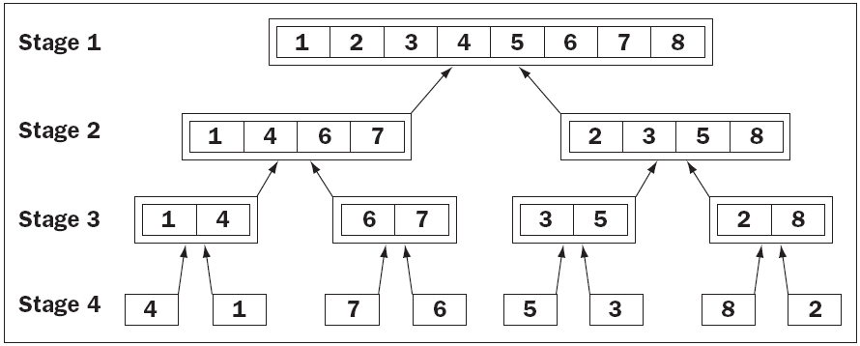
Merge Sort (continued)
Merging the subarrays generated during a merge sort
‹#›
‹#›

Slide 42
Merge Sort (continued)
The merge method combines two sorted subarrays into a larger sorted subarray.
First between low and middle; second between middle + 1 and high.
The process consists of:
Set up index pointers (low and middle + 1).
Compare items, starting with first item in subarray. Copy the smaller item to the copy buffer and repeat.
Copy the portion of copyBuffer between low and high back to the corresponding positions of the array.
‹#›
‹#›

Slide 43
Merge Sort (continued)
Complexity Analysis for Merge Sort:
The run time of the merge method is dominated by two for statements, each of which loop (high – low + 1) times.
Run time: O(high – low). Number of stages: O(log n).
Merge sort has two space requirements that depend on an array’s size:
O(log n) is required on the call stack; O(n) space is used by the copy buffer.
‹#›
‹#›

Slide 44
Merge Sort (continued)
Improving Merge Sort:
The first for statement makes a single comparison per iteration.
A complex process that lets two subarrays merge without a copy buffer or changing the order of the method.
Subarrays below a certain size can be sorted using a different approach.
‹#›
‹#›

Slide 45
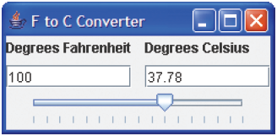
Graphics and GUIs: Drawing Recursive Patterns
Sliders:
A slider is a GUI control that allows the user to select a value within a range.
When a user moves a slider’s knob, the slider emits an event of type ChangeEvent.
User interface for the temperature conversion program
‹#›
‹#›

Slide 46
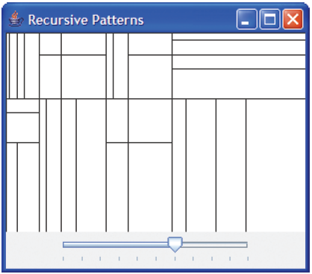
Graphics and GUIs: Drawing Recursive Patterns (continued)
Recursive Patterns in Abstract Art:
Example: Mondrian abstract art.
Art generated by drawing a rectangle, then repeatedly drawing two unequal subdivisions.
Slider allows user to select 0 to 10 for division options.
User interface for the Mondrian painting program
‹#›
‹#›

Slide 47
Graphics and GUIs: Drawing Recursive Patterns (continued)
Recursive Patterns in Fractals:
Fractals: highly repetitive or recursive patterns.
Fractal object: appears geometric, but cannot be described with Euclidean geometry.
Every fractal shape has its own fractal dimension.
C-curve: starts with line.
‹#›
‹#›

Slide 48
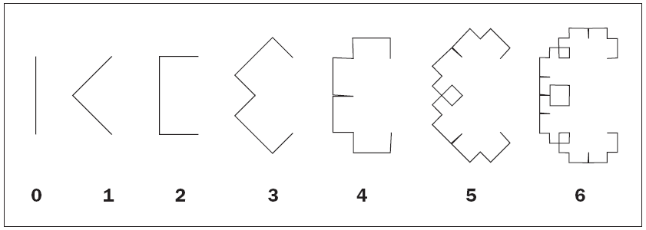
Graphics and GUIs: Drawing Recursive Patterns (continued)
Recursive Patterns in Fractals (cont):
The first seven degrees of the c-curve
The pattern can continue indefinitely.
‹#›
‹#›

Slide 49
Design, Testing, and Debugging Hints
When designing a recursive method, make sure:
The method has a well-defined stopping state.
The method has a recursive step that changes the size of the data so the stopping point will be reached.
Recursive methods can be easier to write correctly than iterative methods.
More efficient code is more complex than less efficient code.
‹#›
‹#›

Slide 50
Summary
In this chapter, you learned:
A recursive method is a method that calls itself to solve a problem.
Recursive solutions have one or more base cases or termination conditions that return a simple value or void. They also have one or more recursive steps that receive a smaller instance of the problem as a parameter.
‹#›
‹#›

Slide 51
Summary (continued)
Some recursive methods also combine the results of earlier calls to produce a complete solution.
The run-time behavior of an algorithm can be expressed in terms of big-O notation. This notation shows approximately how the work of the algorithm grows as a function of its problem size.
‹#›
‹#›

Slide 52
Summary (continued)
There are different orders of complexity, such as constant, linear, quadratic, and exponential.
Through complexity analysis and clever design, the order of complexity of an algorithm can be reduced to produce a much more efficient algorithm.
The quicksort is a sort algorithm that uses recursion and can perform much more efficiently than selection sort, bubble sort, or insertion sort.
‹#›
‹#›

